Slide 1
Projekt Marianne

Slide 2
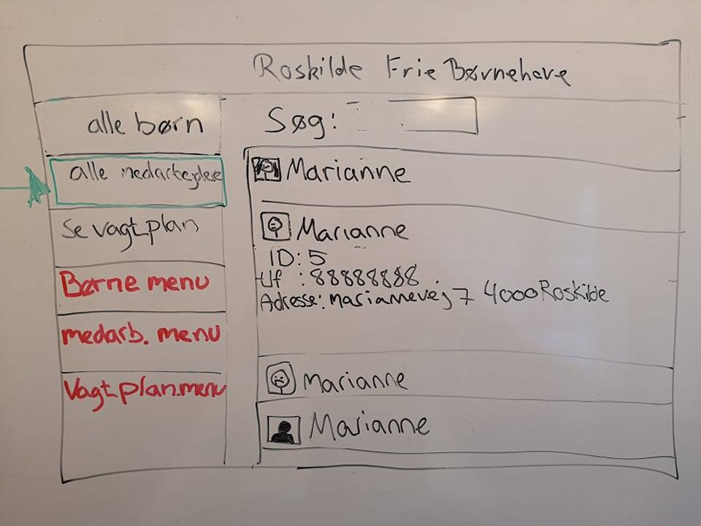
Use case 0: Login & Menu
Leder
Medarbejder

Slide 3
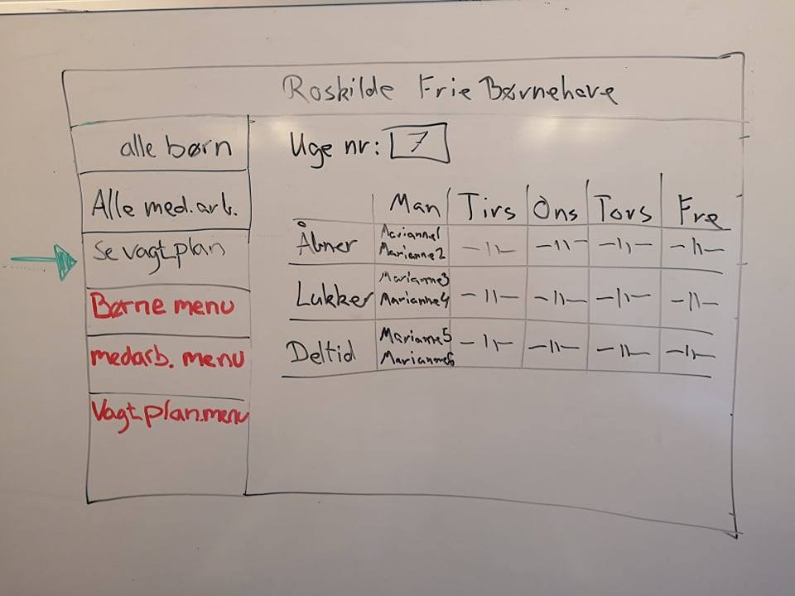
Use case 5: Opret barn
Stakerholders: Manager Staff Kids Parents
Basic flow & alternate flow
Special Requirements

